Slide 1
Unit 4: Using server side control to display data in ASP.NET

Slide 2
Agenda
Using template with listbound control
Practice with DataList control
Practice with Repeater control

Slide 3
Using Templates with List-Bound Controls
Displaying Data in the Repeater and DataList Controls
Using Templates
Demonstration: Using a DataList Control

Slide 4
Overview
Overview of XML Architecture in ASP.NET
XML and the DataSet Object
Working with XML Data
Using the XML Web Server Control

Slide 5
Displaying Data in the Repeater and DataList Controls
Create the control and bind it to a DataSet
Set custom properties
Autoformat
Columns (horizontal vs. vertical columns)
Display data in templates
<asp:Repeater id="repList" runat="server">
<ItemTemplate>
<%#DataBinder.Eval(Container.DataItem, "au_lname")%>
</ItemTemplate>
</asp:Repeater>

Slide 6
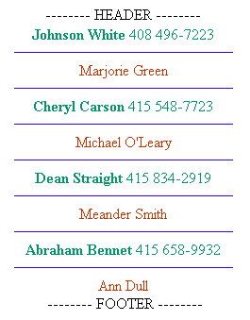
Using Templates
HeaderTemplate
ItemTemplate
SeparatorTemplate
AlternatingItemTemplate
FooterTemplate

Slide 7

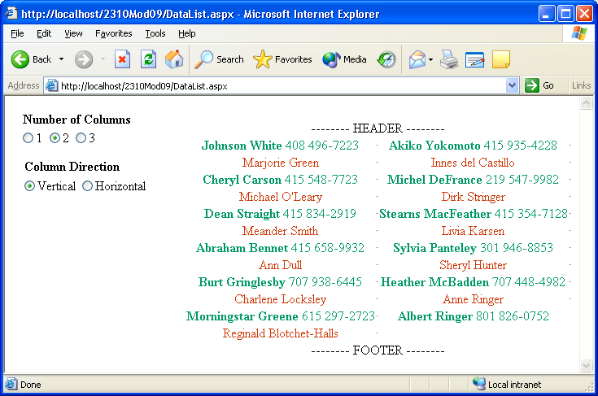
Demonstration: Using a DataList Control

